Slide 1

Flight Delay Analysis and Prediction
DATA 603 Platforms for Big Data Processing
Final Project Delivery Report
Varun Balle Umakanth Ayalasomayajula Mounika Reddy Kummetha

Slide 2

Table of Contents
Problem Statement
Dataset Description
Workflow
EDA
MongoDB
Delay Prediction
Tableau Dashboard
Results
Future Considerations

Slide 3
Problem statement
Develop a flight analysis and prediction system that utilizes historical flight data to provide accurate and reliable predictions of flight delays and cancellations and insights into factors that impact flight performance such as weather conditions, airline performance, and airport congestion.
The system should utilize Tableau to create interactive dashboards and visualizations that enable airlines, airports, and passengers to easily explore and understand the data.
The system should be able to analyze past data to identify patterns and trends and provide recommendations to help stakeholders make informed decisions and improve the overall travel experience.
The system should be scalable and easy to use, with the ability to process large volumes of data quickly and efficiently.

Slide 4
Dataset Description
Data Source: We were able to obtain flight data in the form of individual CSV files from Kaggle.
https://www.kaggle.com/code/ioannistr/visualizing-us-flight-data/input?select=2006.csv - 1987 to 2008
https://www.kaggle.com/datasets/sherrytp/airline-delay-analysis - 2009 to 2019
We considered data for roughly 20 years.
In total there were up to 125 million records of data which take up approximately 1.5GB and 14GB of compressed and raw space.

Slide 5
Dataset Description
Name | Description
Year | 1988-2019
Month | 1-12
DayofMonth | 1-31
DayOfWeek | 1-7
DepTime | actual departure time(local, hhmm)​
CRSDepTime | scheduled departure time (local, hhmm)​
ArrTime ​ | actual arrival time (local, hhmm)​
CRSArrTime | scheduled arrival time (local, hhmm)
ArrDelay | Arrival delay in minutes
DepDelay | Departure delay in minutes
AirTime | Total airtime in minutes
Origin | Origin airport code

Slide 6
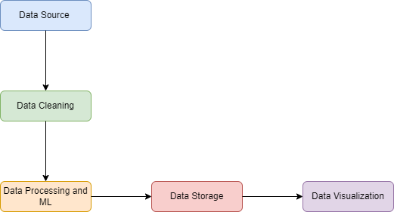





Workflow

Slide 7

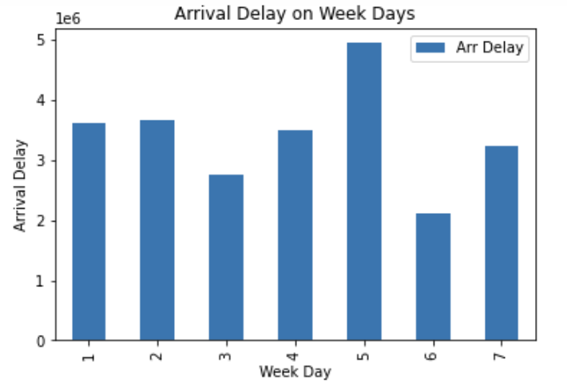
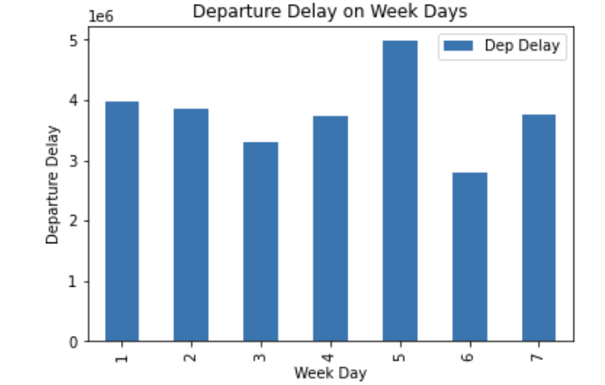
EDA

Slide 8
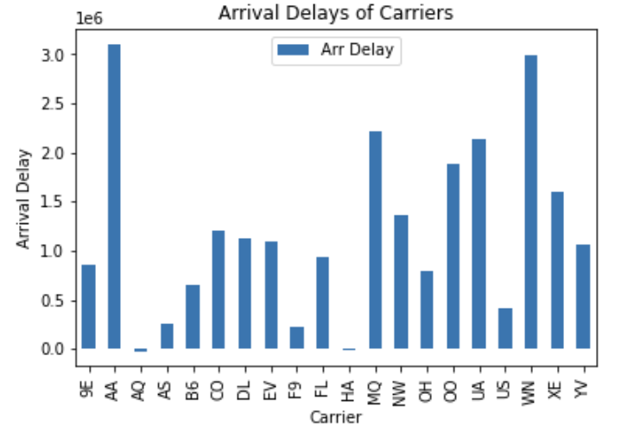
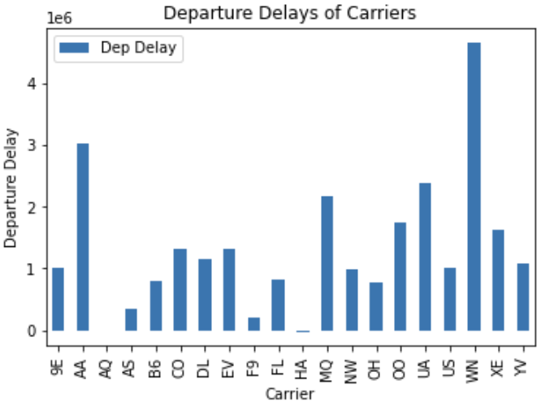
EDA

Slide 9
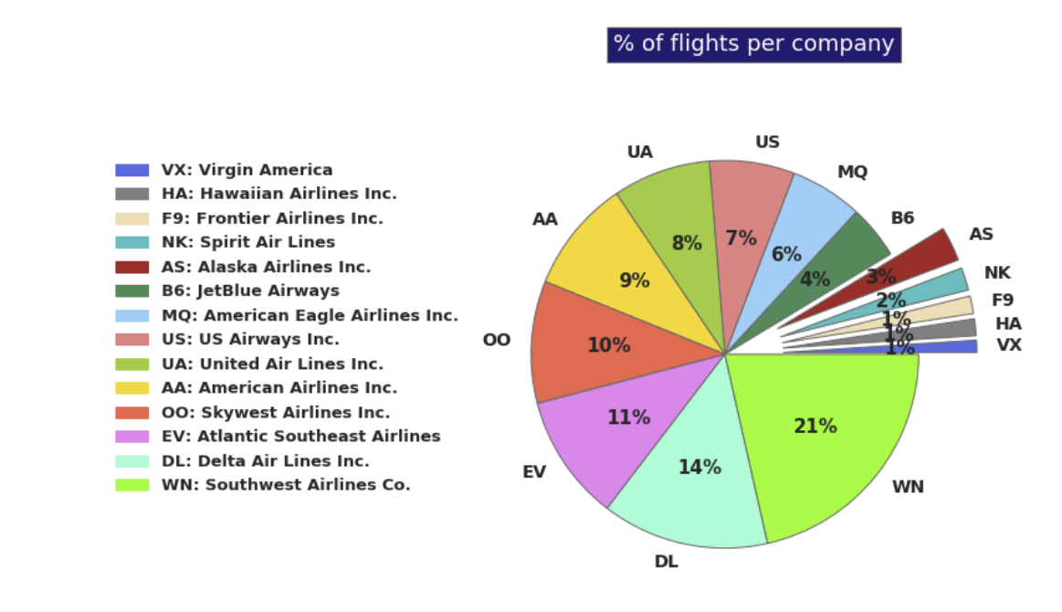
EDA

Slide 10
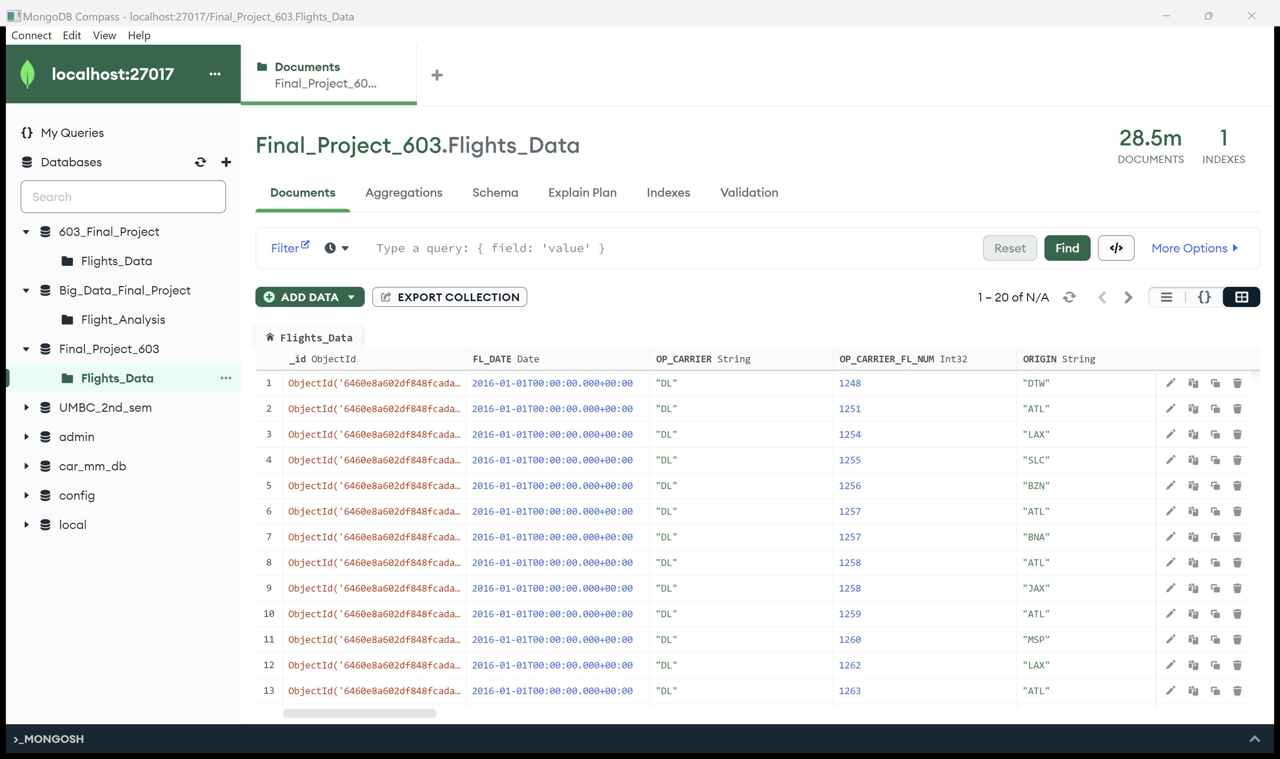
Data feeding to MongoDB
Data consisting of 28.5 million records was imported into MongoDB.
For accurate analysis of recent flight delay patterns, data from the years 2016-2020 was stored.
Data was imported in .csv format and stored in the database.
Data, specific to the requirement was added to the collection.

Slide 11
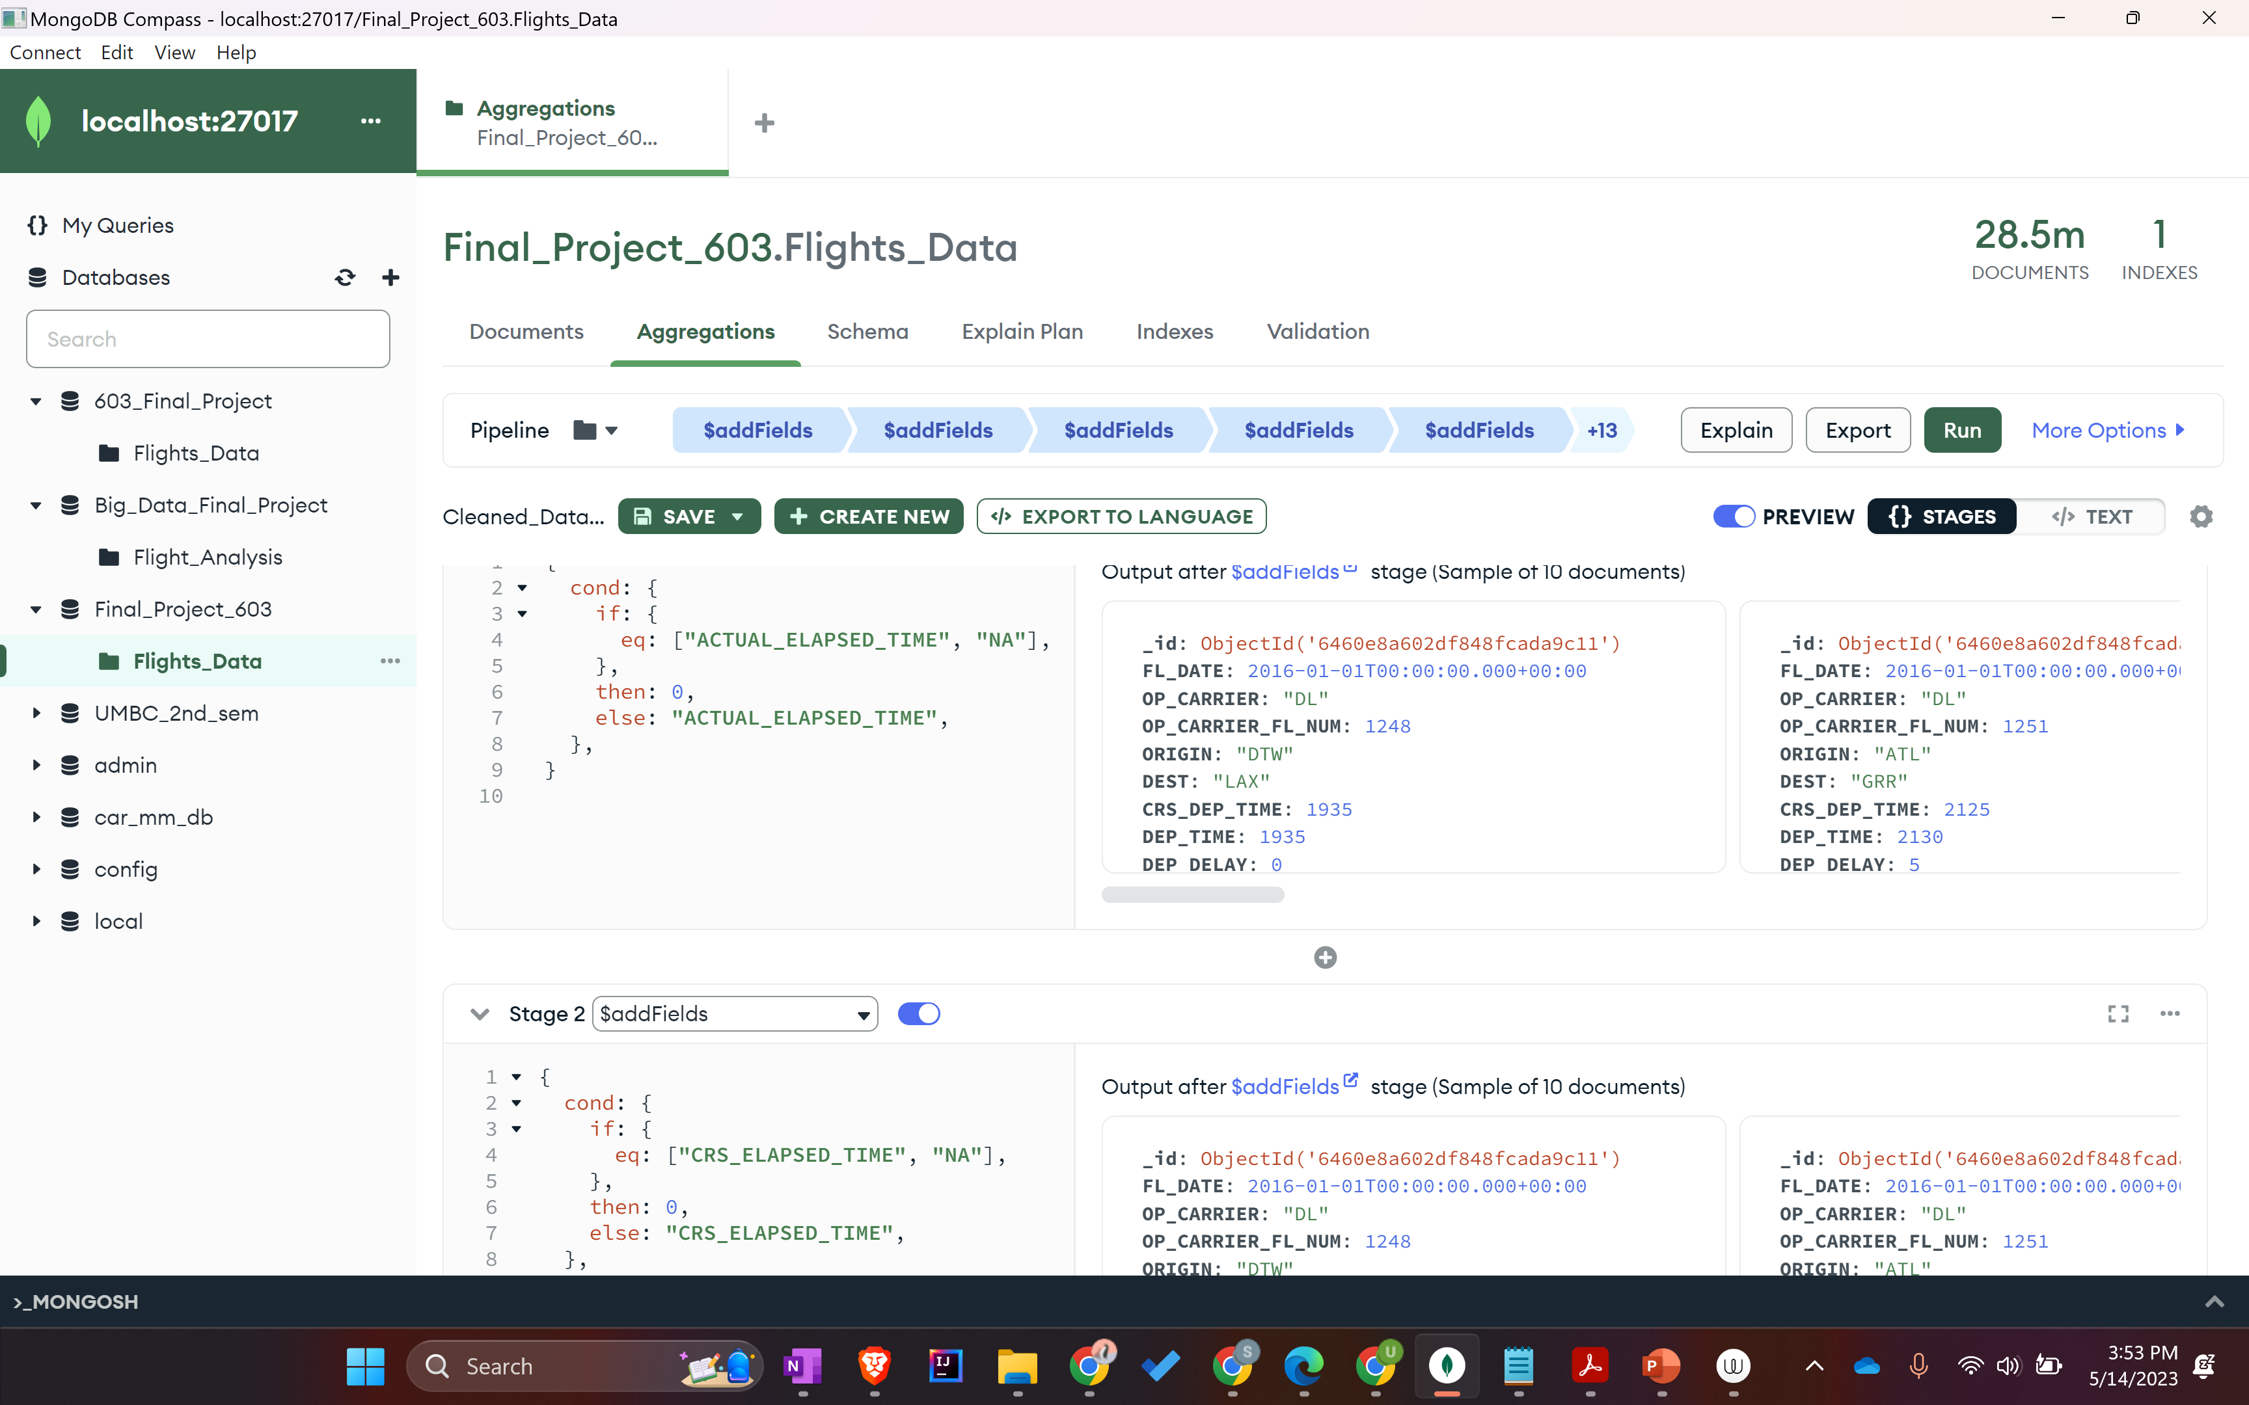
Data cleansing using MongoDB
Data cleansing was performed using in-built aggregate functions present in MongoDB.
Queries were run to remove null values, remove duplicates and replace irrelevant values in the pipeline.
The cleaned data set was then downloaded and exported into a separate .csv file containing the combined data.

Slide 12
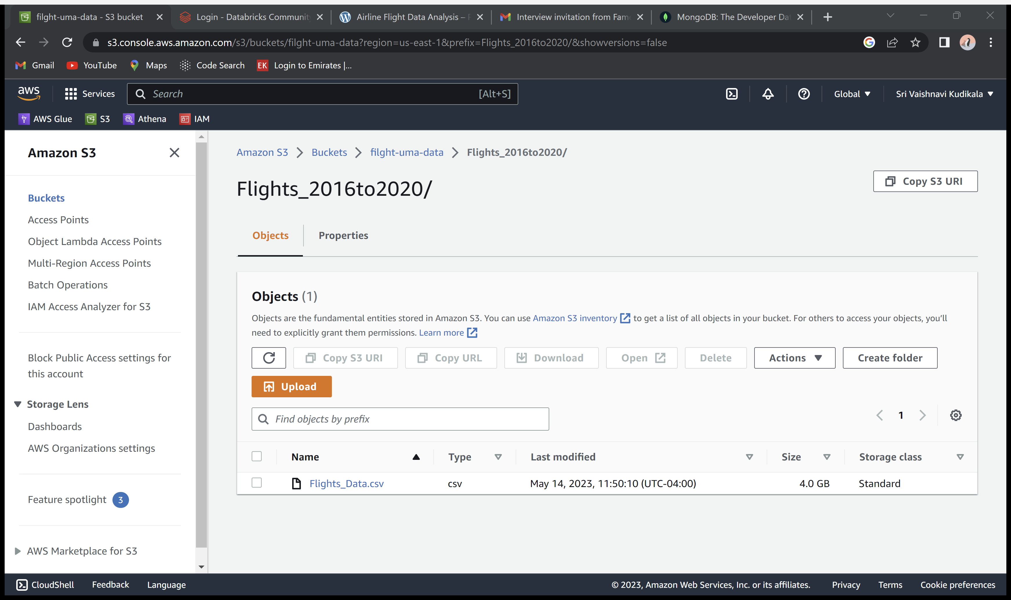
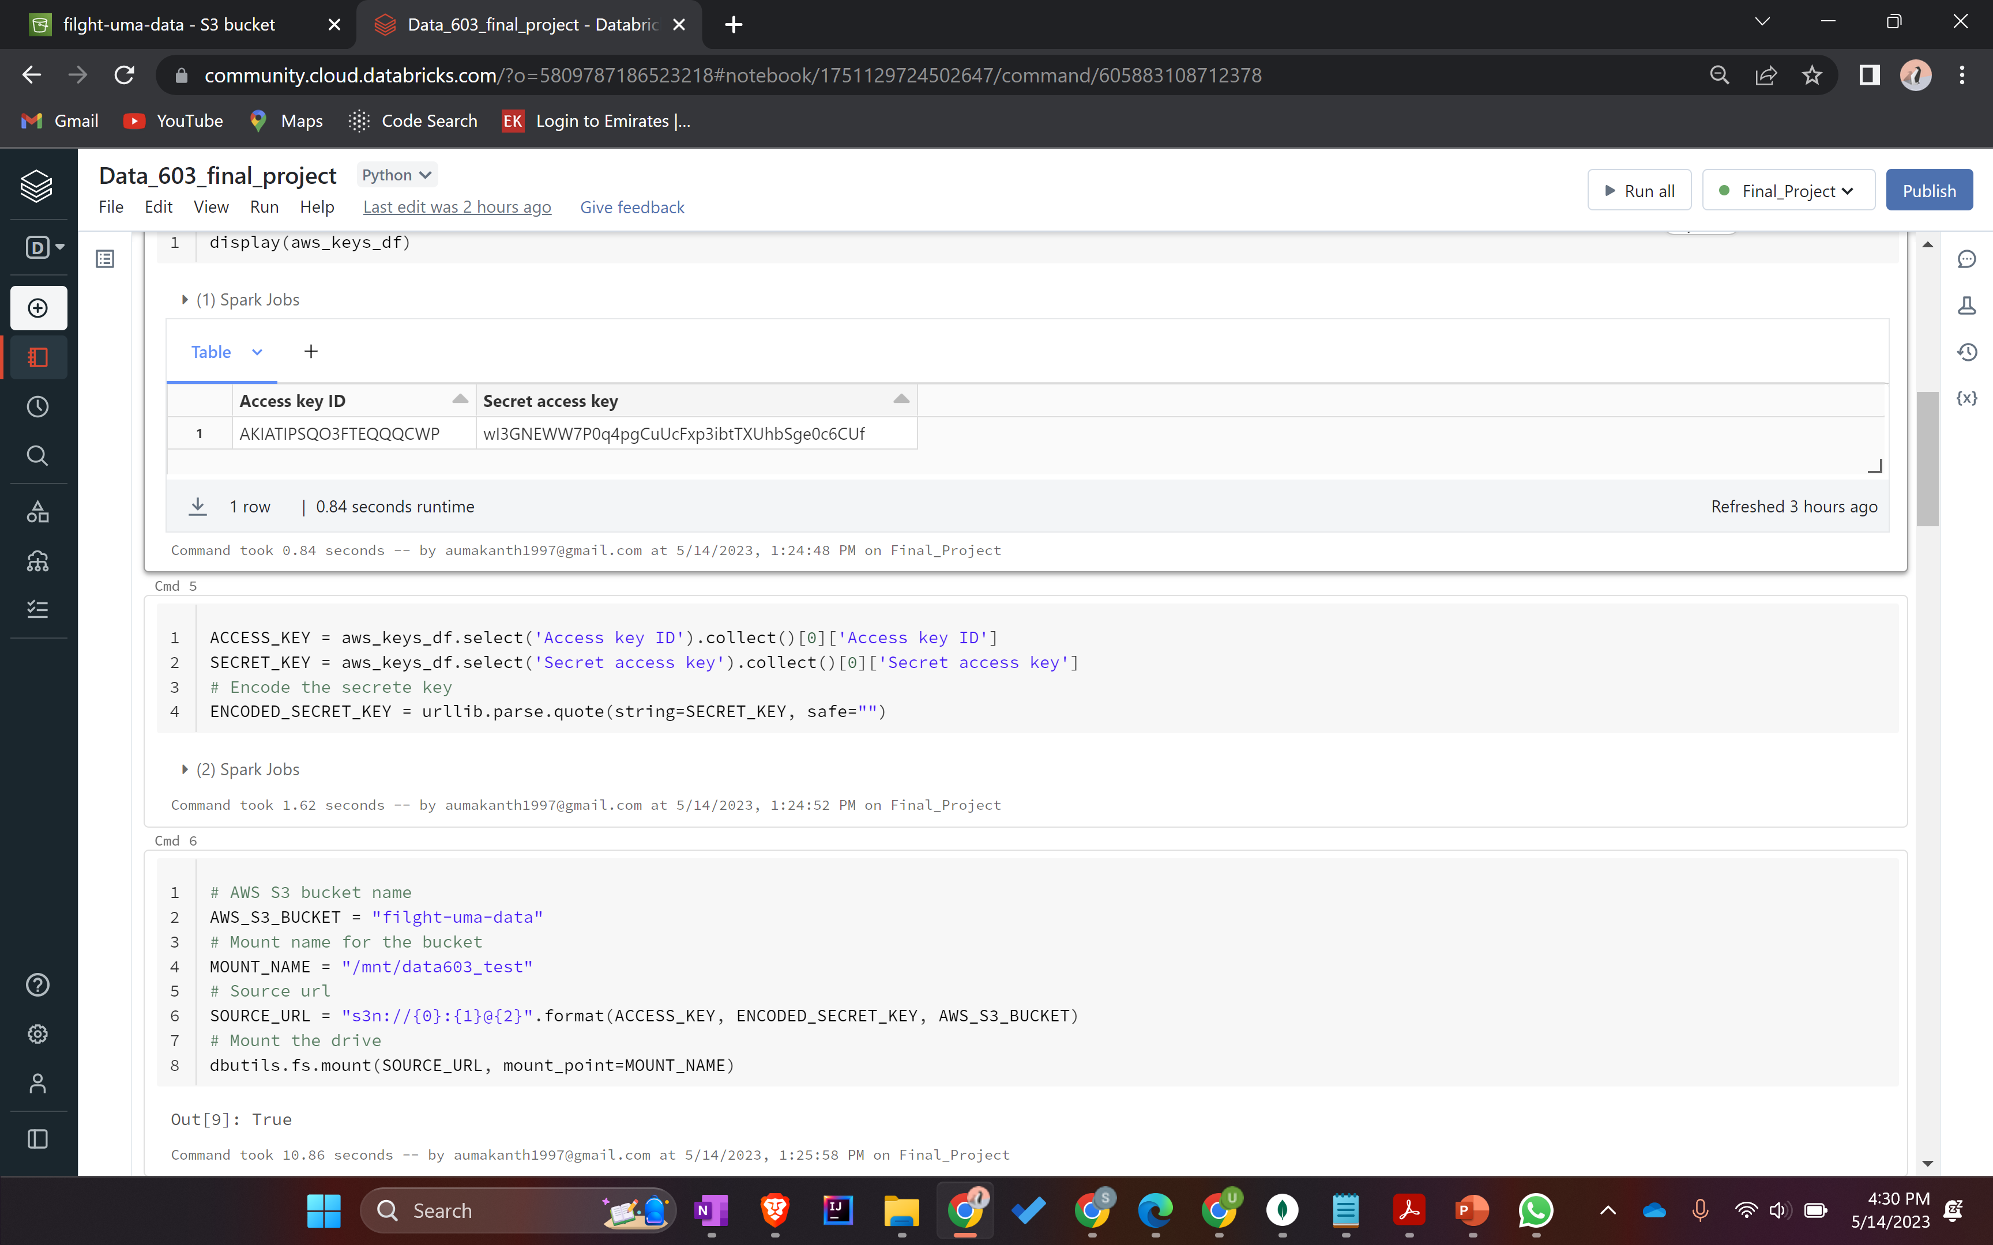
Data upload to S3 and connection with Databricks
The cleaned data from MongoDB was uploaded to Amazon S3 bucket.
Amazon S3 was connected to Databricks to perform Spark operations on the data.
Data from S3 was accessed in Databricks using the access ID and secret access key.
Data from S3 was used for visualizations and predictions.

Slide 13
Delay prediction

Slide 14
Delay Prediction

Slide 15
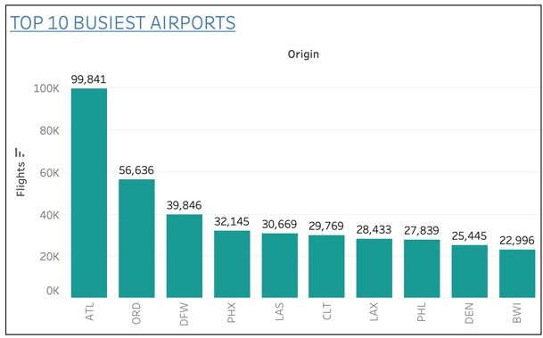
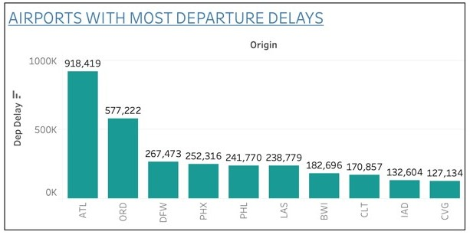
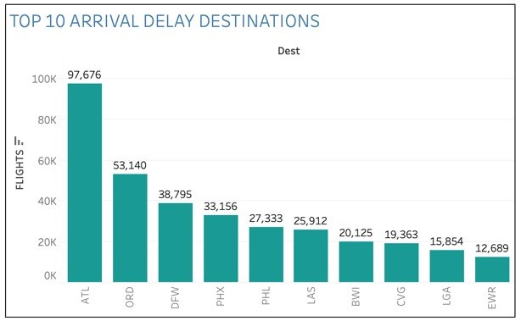
Tableau Dashboard

Slide 16
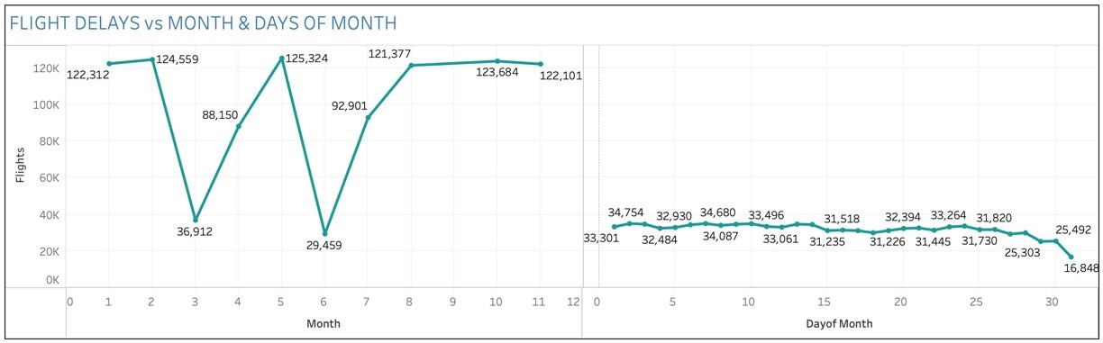
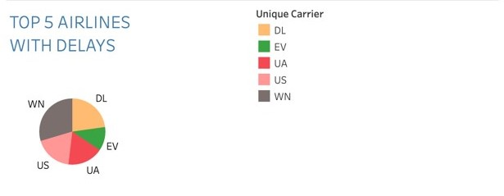
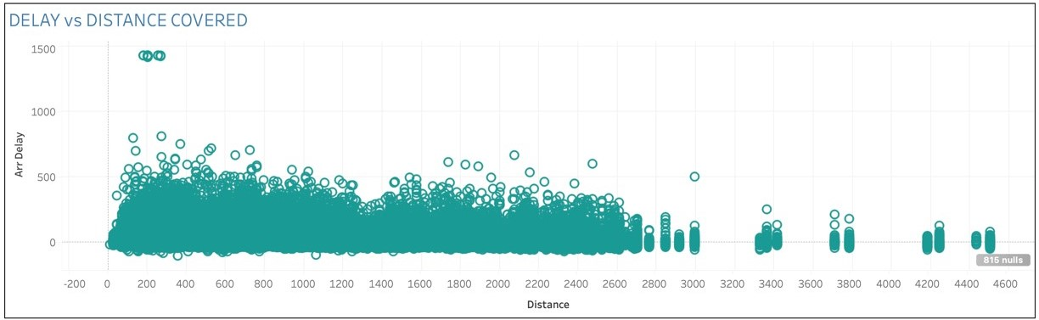
Tableau Dashboard

Slide 17
Results
Atlanta (ATL) is the busiest airport, followed by Chicago (ORD).
From our analysis, Southwest Airlines have the most delay.
March and June are the months with lower flight delays while February and May have higher flight delays.
Airports with high traffic experience more departure delays and arrival delays.
Departure delays are highly influenced by arrival delays.
There is no major dependency on arrival delay based on the distance.

Slide 18
Future Consideration
Implementation of a cloud platform with real-time updates.
Creating a web application to deliver the above using Flask.

Slide 19
Thank You!
Questions?

